Slide 1
Capstone Mid-Quarter Update
UCSD WES MAS
Bryce Rooney

Slide 2
Agenda
Project Description and Overview
Methods of Evaluation
LoRa Waveform
Current Schedule and Success
Future Schedule
Test Approach
Development Efforts
Test Bed and Equipment
Results So Far

Slide 3
Quantitative Evaluation of LoRa Resiliency, Detectability, and Geolocation
Characterize the performance of the LoRa Radio Frequency (RF) Chirp Spread Spectrum (CSS) modulation with methods used by the Department of Defense (DoD).
Anti-Jam and Range performance
Probability of Detection
Probability of Geolocation
Collaborate with Naval Information Warfare Center, Pacific (NIWC Pac) Division 535 to leverage existing facilities and equipment.
Write a research paper on findings with insight into desired (or not desired) characteristics and how this fits into DoD Advanced Tactical Data Links (ATDL) research and development.

Slide 4
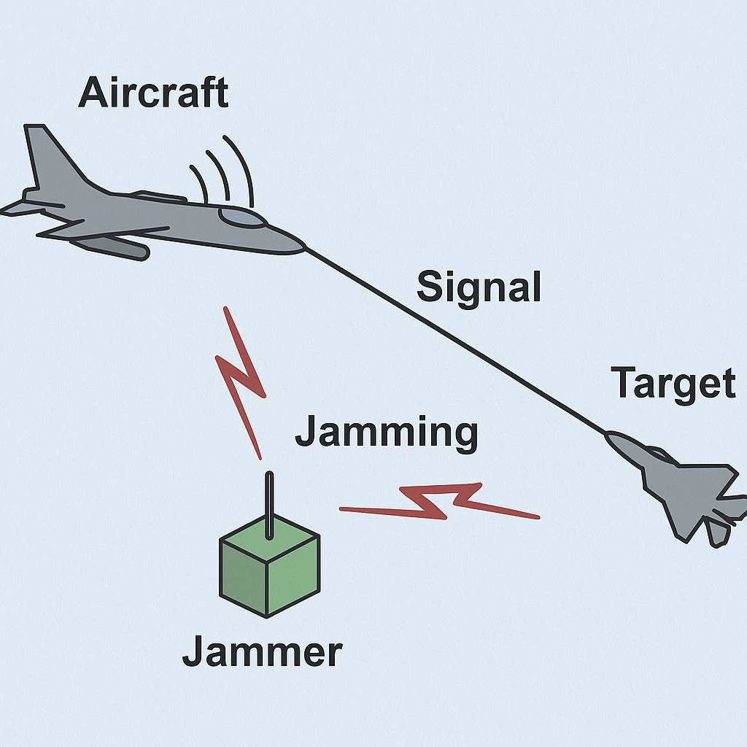
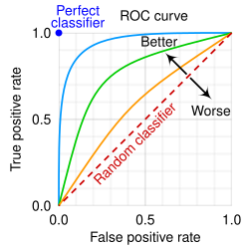
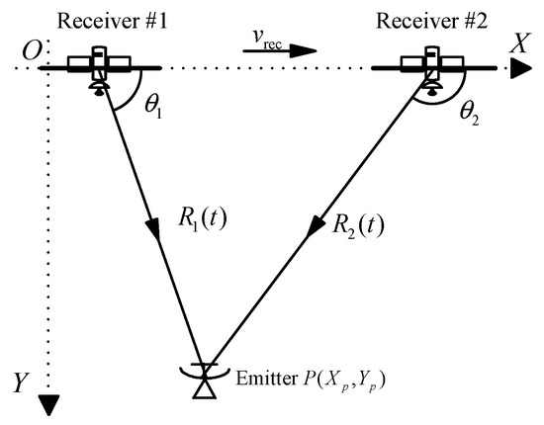
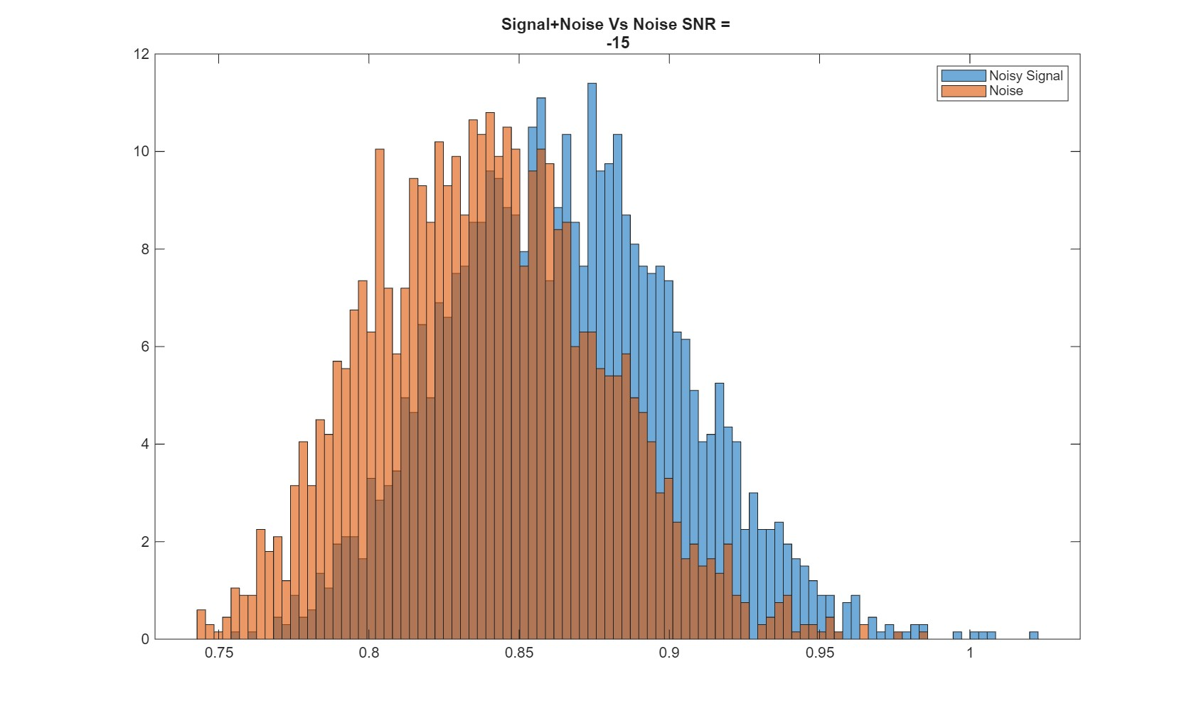
Methods of Evaluation
Probability of Detection (LPD)
Geolocation Avoidance
Anti-Jam and Range Performance

Slide 5
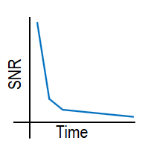
Probability of Detection
Methods and Techniques
Radiometry (energy-based detection)
Computational-heavy MATLAB Algorithm
Compares signal to Gaussian noise
Quantitative Metrics
Receiver Operating Characteristic (ROC) Curve
Probability of true positive detections against false positive detections
Slash curve
Depicts the relationship between SNR and integration time for a given probability of true detection

Slide 6
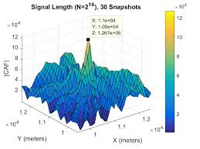
Geo-location Avoidance
Methods and Techniques
Cross Ambiguity Function (CAF) Analysis
Time Difference of Arrival (TDOA)
Frequency Difference of Arrival (FDOA)
Quantitative Metrics
CAF output
Peak Magnitude and radius

Slide 7
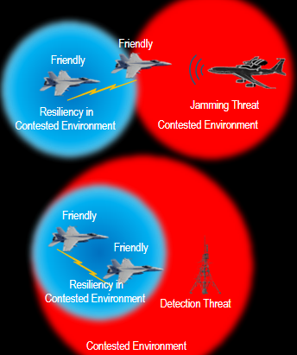
Anti-Jam and Range Performance
Methods and Techniques
Radio Channel Emulator (RCE)
Live Scripts for RCE control
Simulated distances and signal level analysis
Jamming insertion
Quantitative Metrics
Range Ratio – Jamming
ratio of the distance to a friendly receiver versus the distance to a jamming threat
Range Ratio – Detection
ratio of the distance to a friendly receiver versus the distance to a threat detector in an LPD environment
Notes:
What noise types.

Slide 8
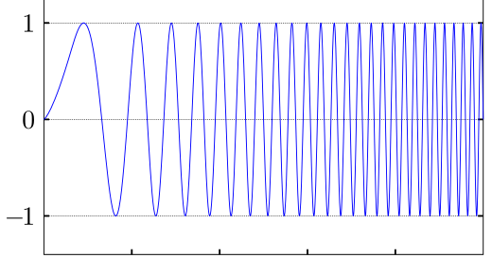
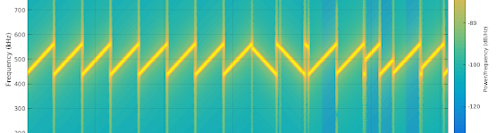
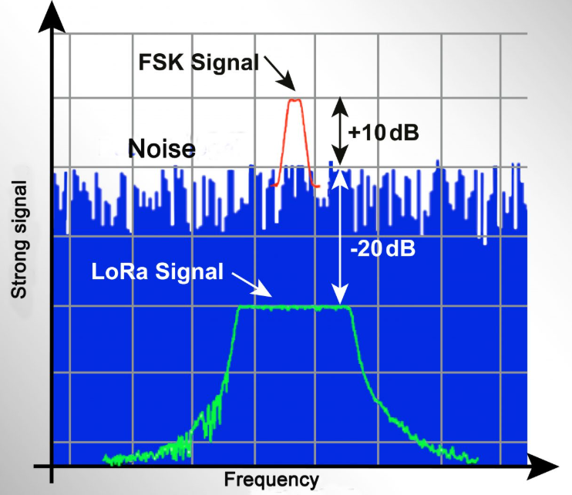
Long Range (LoRa) Chirp Spread Spectrum (CSS)
Proprietary modulation technique
Commercial Off-The-Shelf (COTS)
Extremely Low Cost, Size, and Power consumption
Modulation uses “Chirps” – linear sweeps in frequency
Receiver Sensitivity can be below thermal noise floor – valuable for range and resiliency performance

Slide 9
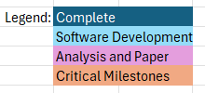
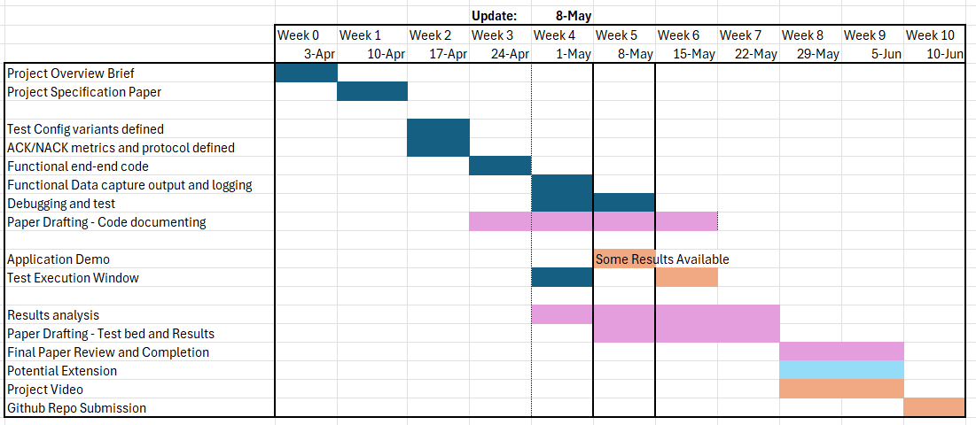
Schedule and Progress (May 8)

Slide 10
Upcoming Milestones
Test Execution Dates
Anti-Jam / Range: 8 May
Geolocation / CAF: 10 May
Paper Drafting Full Effort
15 May
All Data/Metrics exported from Lab
May 19
Paper First Draft
May 24
Video Presentation Full effort
May 29
Paper and Video Submitted
June 5

Slide 11
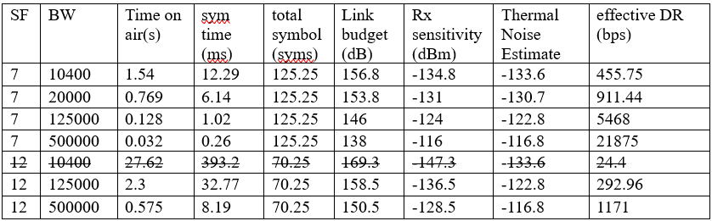
Test Approach
Iterative testing against various LoRa Configurations
Spread Factor (SF) and Bandwidth (BW) variations
Other Interpretation:
At set SF how effective is changing the BW?
At Set BW, how effective is changing the SF?
At set effective data rate, compare the performance of small SF and short BW against high SF and long BW. (SF7 @ ~25kHz vs SF12 @ 500kHz)
Compare Results to other waveforms as possible (scrub proprietary and Controlled Unclassified Information (CUI)

Slide 12
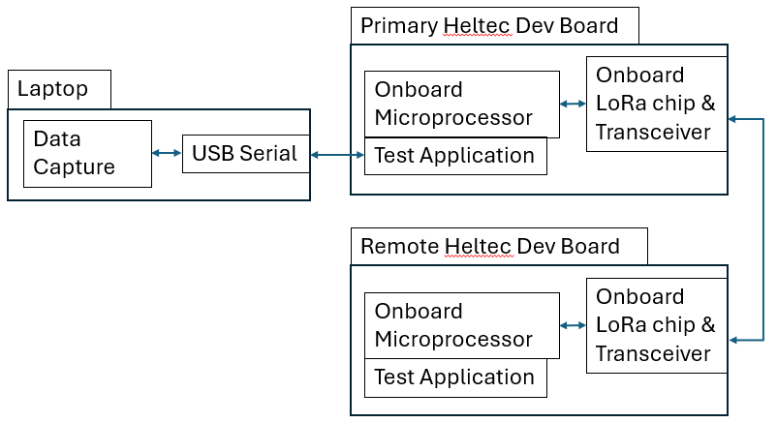
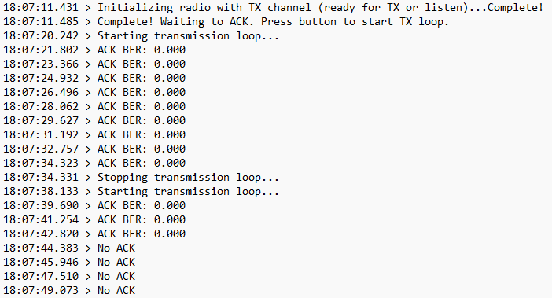
Development Efforts
LoRa development boards (Heltec LoRa V3)
Visual Studio Code C++
Platform IO extension
“Application” traffic exercises waveform signal
50B payload transmitted ~once per second
ACK/NACK between the two with output logging
Single code base for quick uploads between test configs
SF and BW inputs with dynamic protocol adjustment to minimize iterative testing
Code base works as ACK device or Tx device with button toggle
Notes:
Published results to find. Google scholar
Connected papers
This weekend.

Slide 13
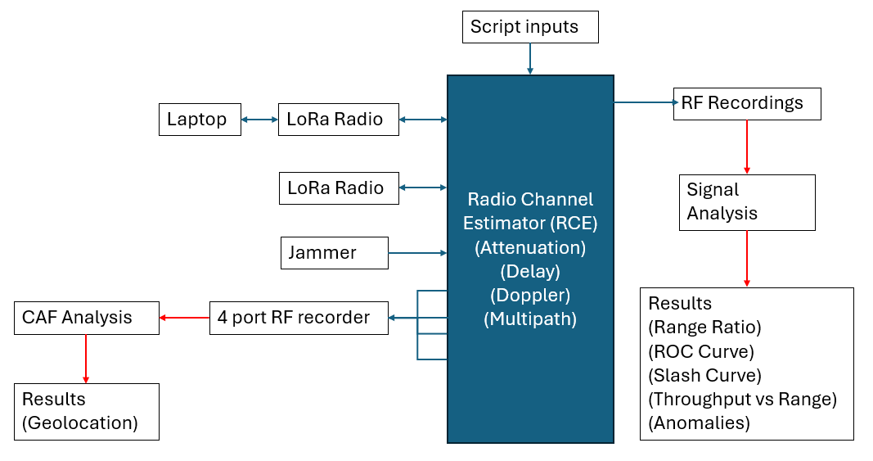
Test Bed and Equipment
Notes:
EW cert
RSSI values in ACK, SNR
Other values

Slide 14
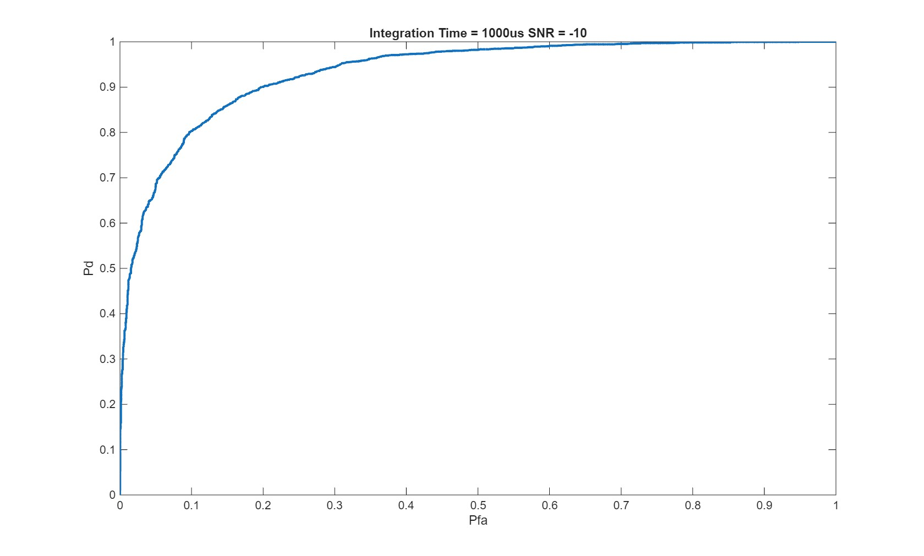
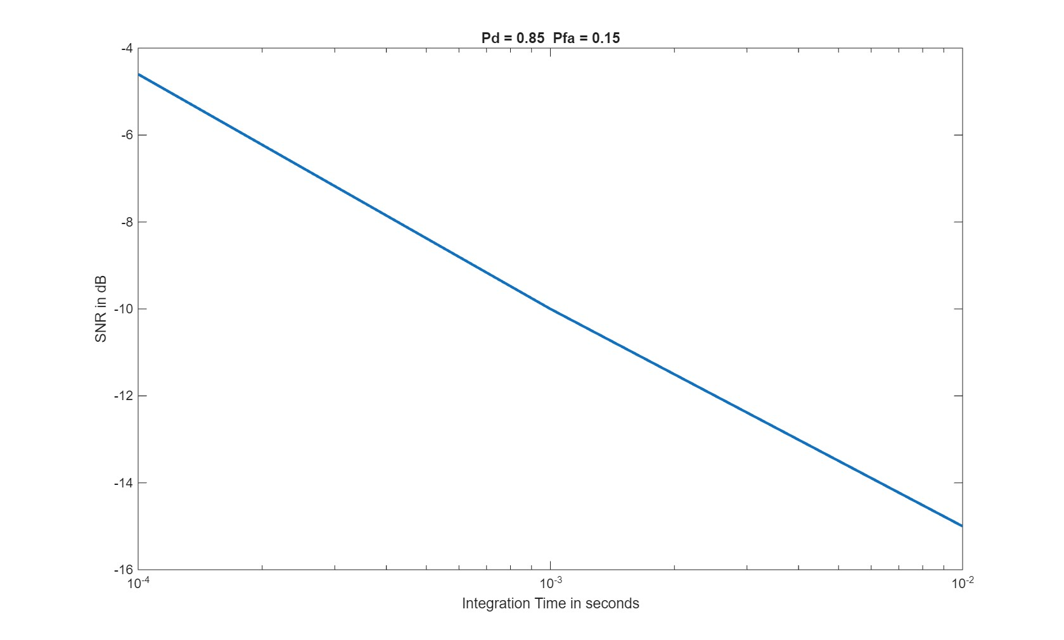
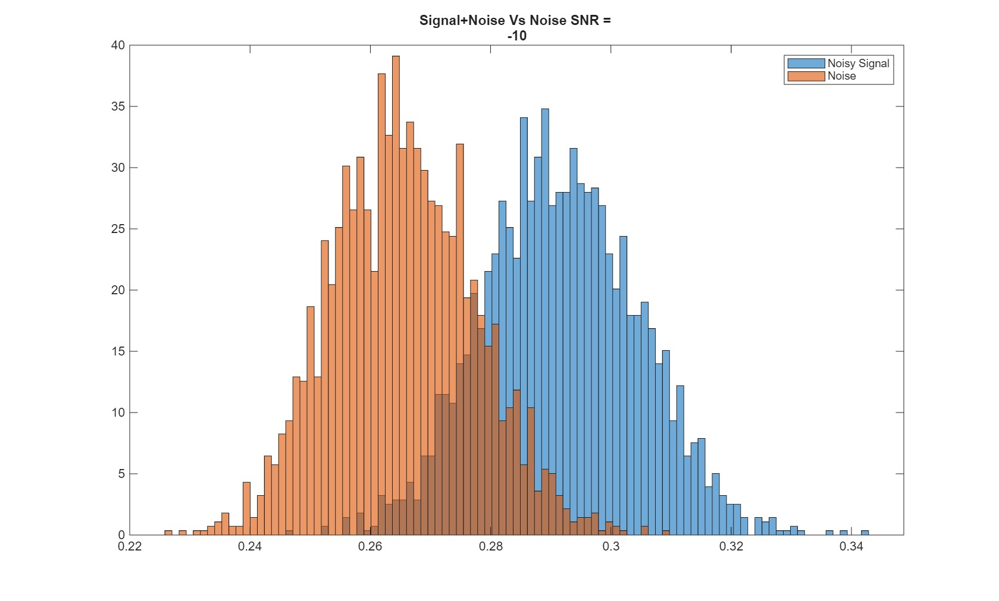
Results so Far
Detectability test cases with all LoRa configs
Met obstacles in RF recording and MATLAB algorithm parameters
Confirmed valid output metrics.
All data being processed
ROC & Slash Curves with Histograms

Slide 15
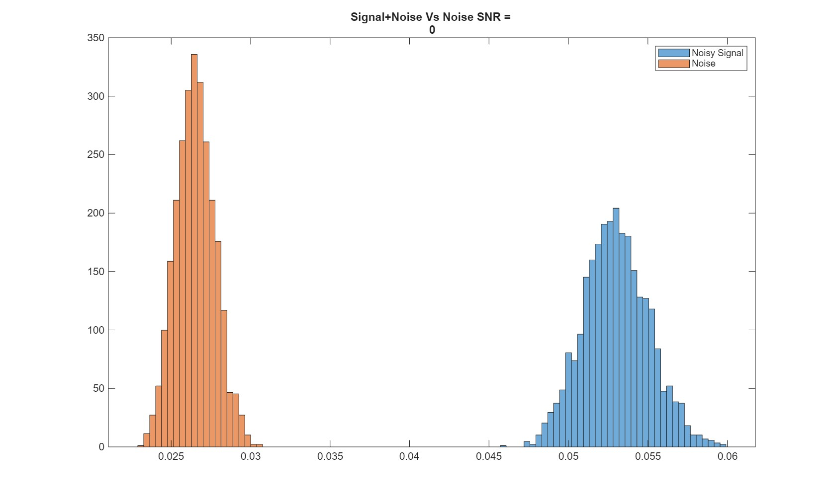
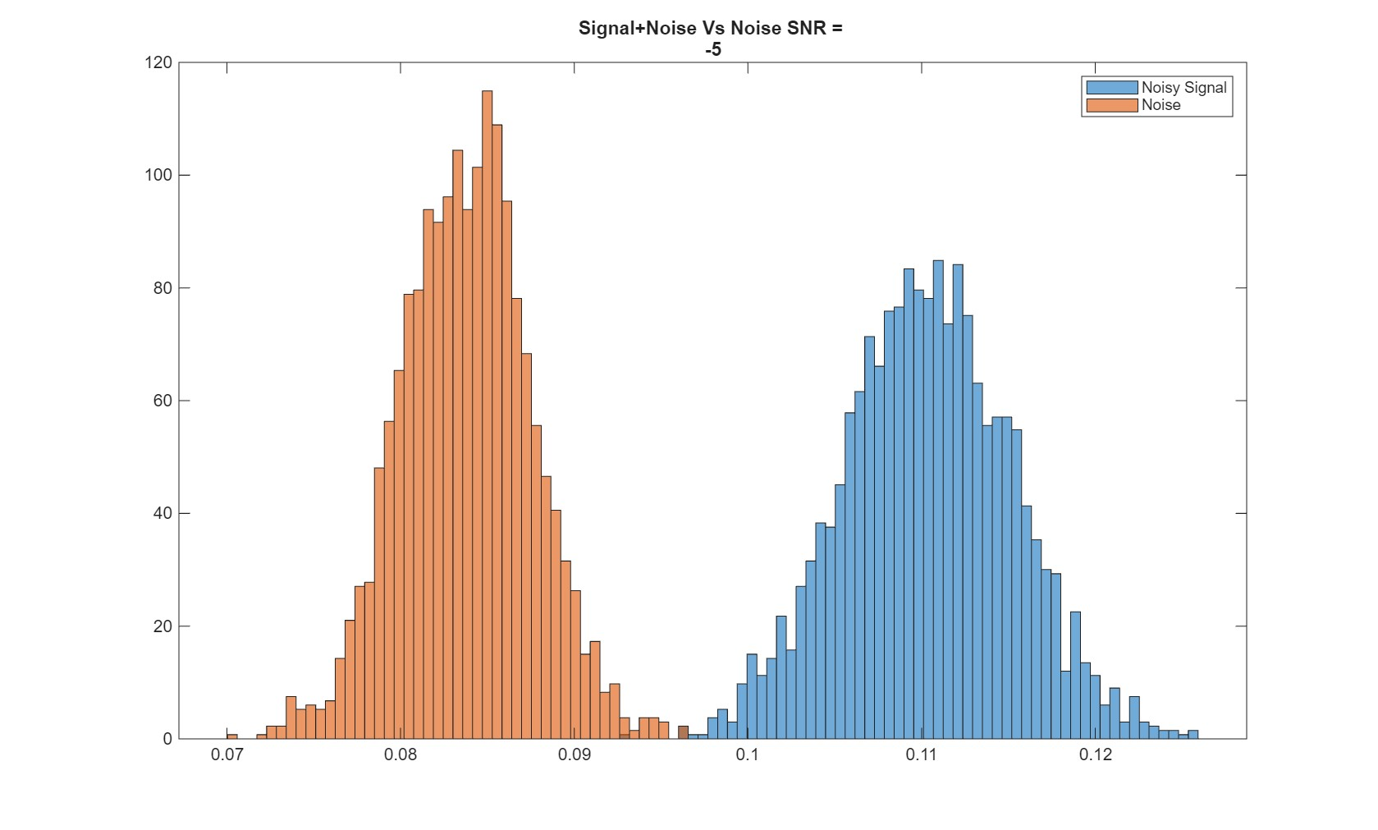
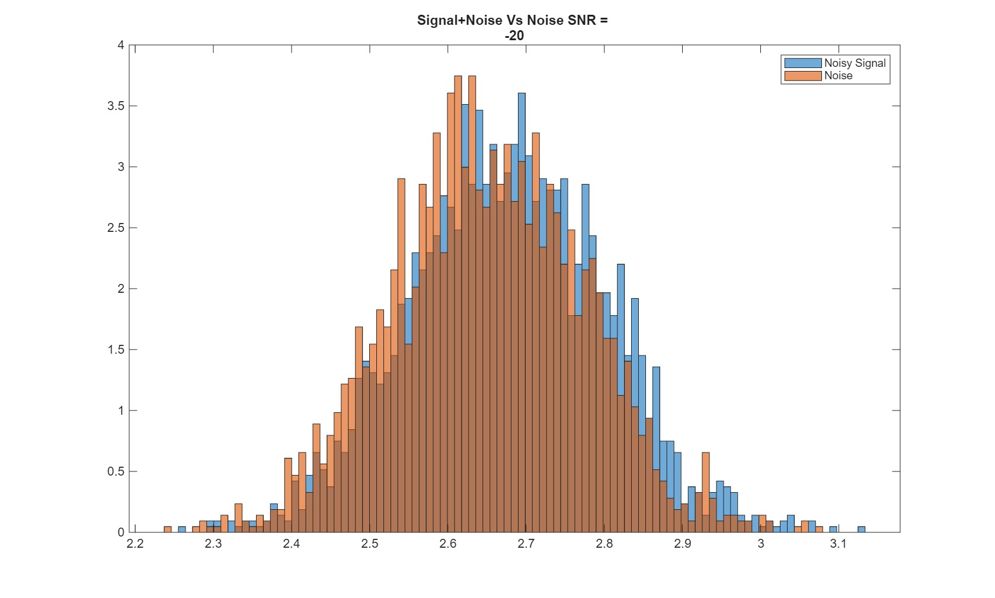
Histograms
SNR 0 dB
SNR -5 dB
SNR -10 dB
SNR -15 dB
SNR -20dB

Slide 16
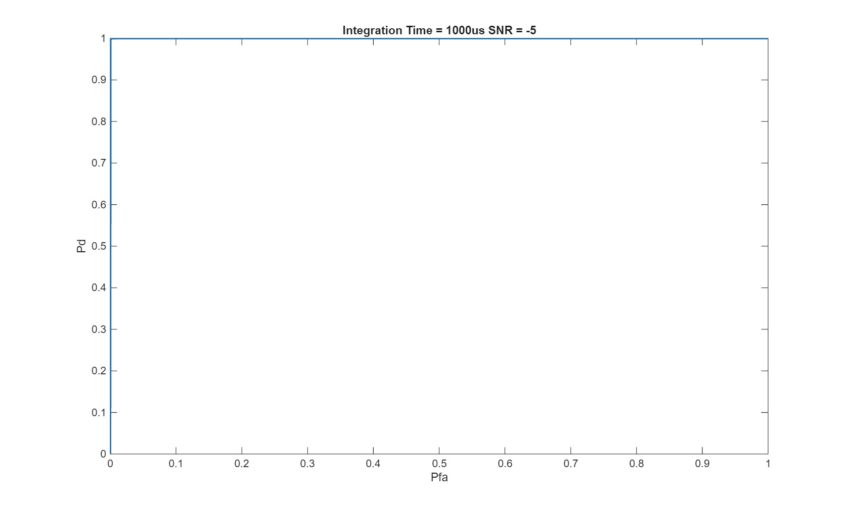
ROC Curve (0 & -5 dB SNR)

Slide 17
ROC Curve (-10dB SNR)
Notes:
Wiki pedia on ROC
Threshhold details

Slide 18
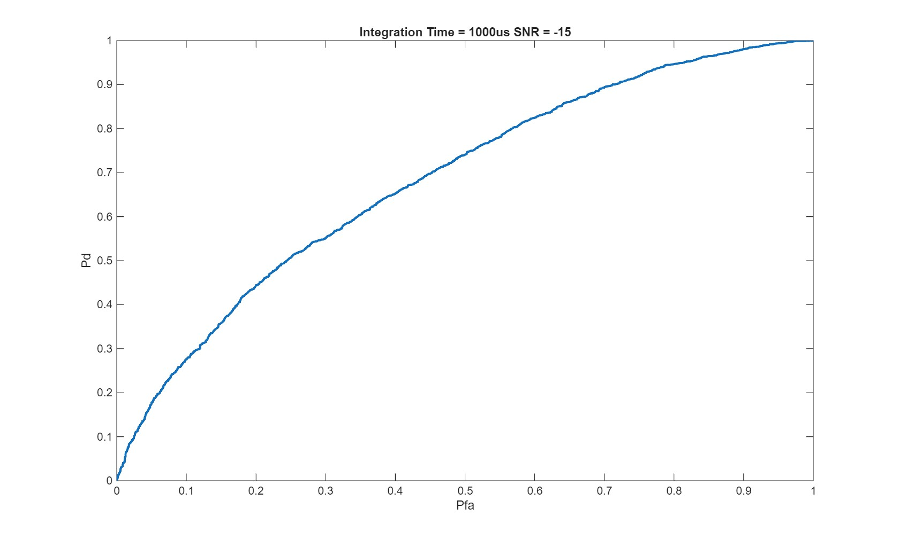
ROC Curve (-15dB SNR)

Slide 19
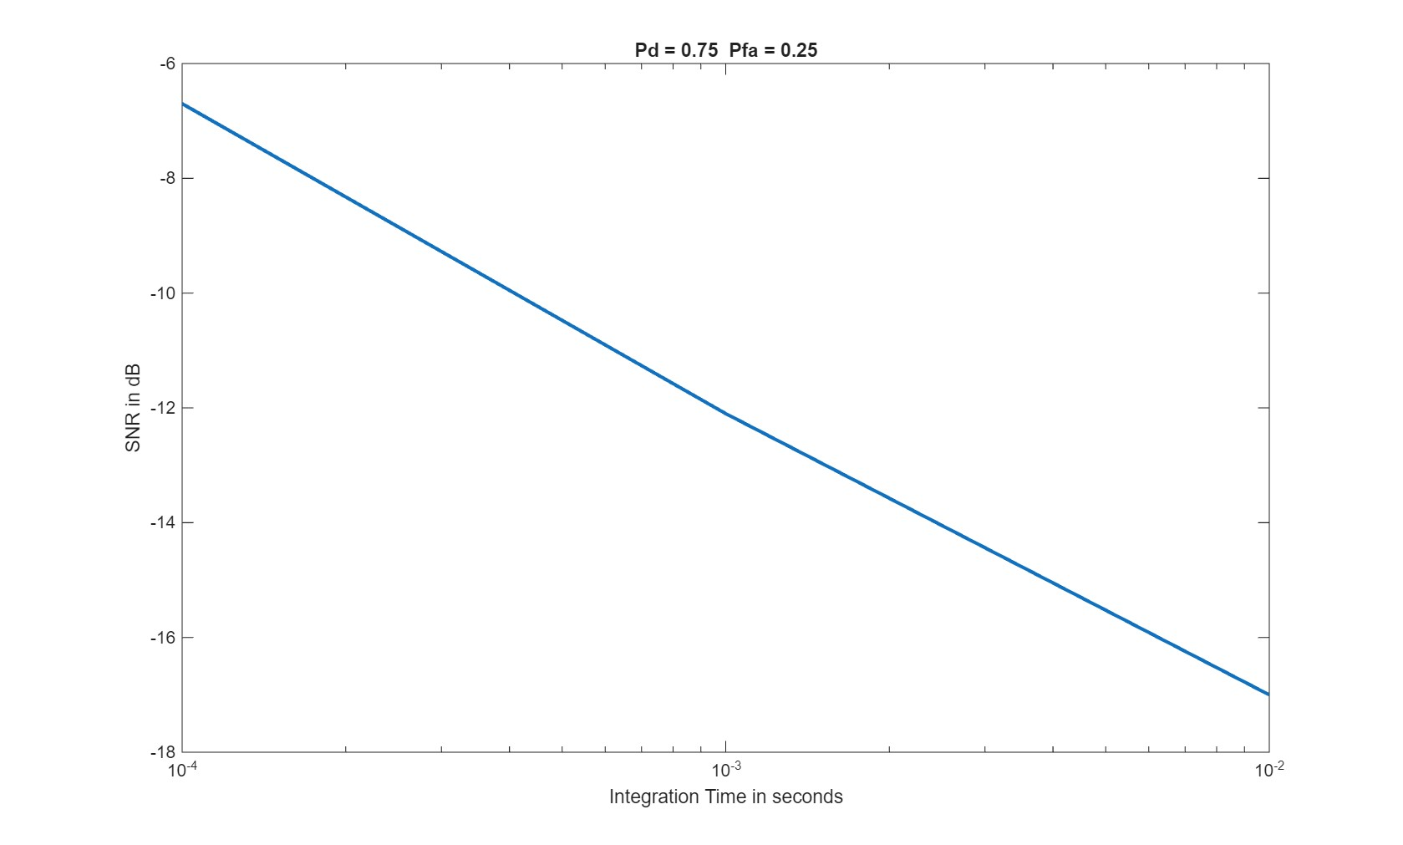
Slash Curve (Pd = .75, Pfa = .25)

Slide 20
Slash Curve (Pd = .85, Pfa = .15)

Slide 21
ROC Curve (-10dB SNR)

Slide 22
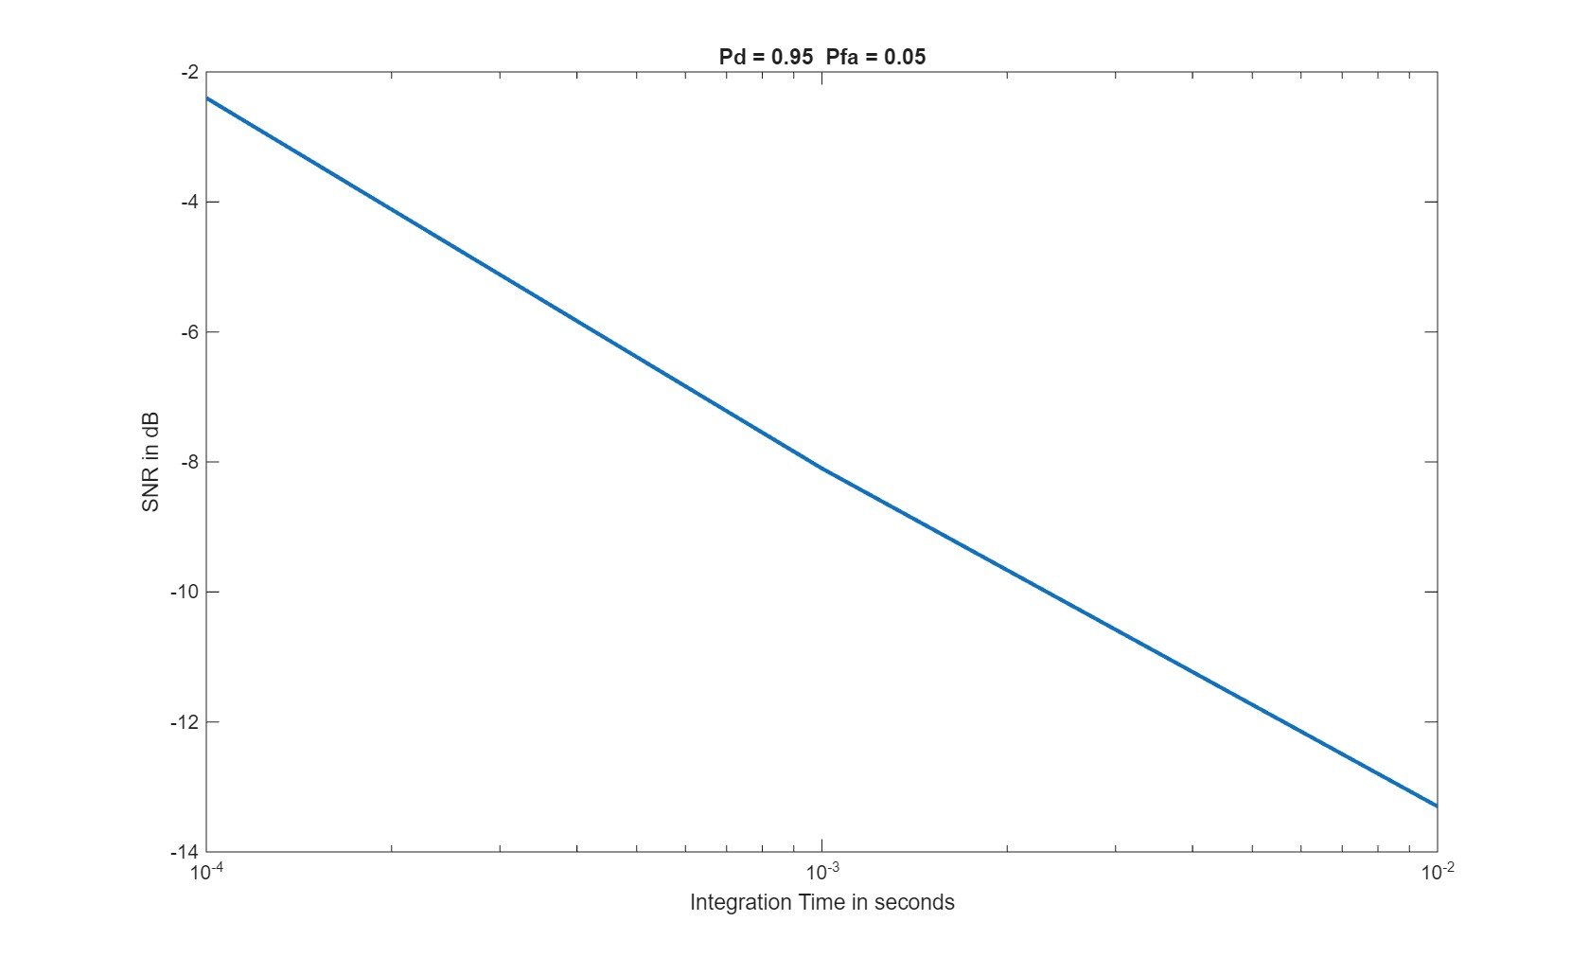
Slash Curve (Pd = .95, Pfa = .05)

